Slide 1
Stanford-Sequoia Tri-District (3-D) SUHSD Board Update
November 13, 2019
Notes:
JEN

Slide 2
Agenda
Describe the context and motivation for this project
Explain the research design and methodology
Share preliminary findings
Summarize next steps and implications for practice
Notes:
Introduce yourselves

Slide 3
Broad Context
This project focuses on students categorized officially by state policy (and now federal guidance) as Long Term English Language Learners (LTELs)—students who have been classified as English learners for six or more years.
Schools are required to collect data on students classified as LTELs, yet we know very little about:
The characteristics of students within the category
The impact of the category on students’ achievement and overall school experience
Notes:
JEN

Slide 4
Problems of Practice
Foci for 2018-2019:
What factors influence how students become LTELs?
What factors shape the ways in which ELs are identified, supported, taught, and assessed?
What do we know about LTELs’ access to college-preparatory mathematics classes in SUHSD?
Notes:
JEN

Slide 5
Activities
In 2018-2019, the QUALITATIVE team...
Carried out exploratory case study analyses of twelve 10th grade LTEL students at Menlo Atherton and Sequoia high schools
Analyzed individual course enrollment patterns for case study students
Observed case study LTELs over a two-day period in all content classes in which they were enrolled
Conducted an initial examination of the ways in which cumulative (CUM) files might be useful in helping project partners learn more about LTEL students’ course taking trajectories.
In 2018-2019, the QUANTITATIVE team..
Analyzed mathematics course pathways at SUHSD
Analyzed mathematics course passing rates, by language designation
Notes:
JEN

Slide 6
Math Enrollment Patterns
Of the twelve 10th grade case-study students at Menlo-Atherton, 2 were enrolled in Geometry: a 10th grade-level, college-prep course
At Sequoia, only one 10th grade case-study student was enrolled in Geometry
The remaining students were enrolled in a range of courses:
Remedial/Supplementary
Algebra Topics
Algebra Topics Support
Algebra I-P Support
College-preparatory, below grade-level
Algebra I-P
Integrated Math
Notes:
Guadalupe

Slide 7
Math Enrollment Patterns
These enrollments may reflect important differences in students’:
mathematics backgrounds
their opportunity to learn
their ability to successfully demonstrate their knowledge or understanding of mathematics concepts on placement assessments
Such test performance might also reflect students’:
limitations in English reading
inconsistent knowledge of mathematical vocabulary and phraseology

Slide 8
ELA Enrollment Patterns
Of the twelve 10th grade case-study students at MA, 3 students were enrolled in English II-P with support and Acad English II: 10th grade college-prep English courses
At Sequoia, three 10th grade students were also enrolled in English II-P and Acad English II
The remaining students were enrolled in a range of courses:
English I support
English II support
English II intensive

Slide 9
Enrollment Histories
Given the language implications of the LTEL category, we found it noteworthy that more students (6 out of the 12) were enrolled in 10th grade English while only 3 out of 12 were enrolled in 10th grade Math.
Some students doing grade level work were also enrolled in concurrent support classes.
Without more information about the differences among and between LTELs, it will be difficult for schools to:
differentiate them from short-term English learners (STELs)
design instruction that can support their specific limitations

Slide 10
Classroom Observations
Classroom observations were conducted both in the fall of 2018 and the spring of 2019.
Fall observations suggested that data systems in place might make it challenging for teachers to identify LTEL students.
In the spring, case study students were observed in all their content classes over a 2-day period during the last two weeks of school.
Notes:
This is from our February report:
By comparison with the information elicited in interviews with administrators, classroom observations and our request to teachers for identification of LTEL students in classes suggest that data systems such as Infinite Campus might not make it easy to identify LTEL students by their teachers. (One administrator stated that LTELs were not specifically identified on Infinite Campus at the school). In the classes we visited, teachers struggled to identify LTEL classified students for us. In some classes, we were given seating charts with RFEP students identified and in others, ELs were identified in computer rosters but not LTELs. We found much confusion surrounding the many acronyms used to identify different members of the EL-identified group (e.g., Reclassified Fluent English Proficient (RFEP), Initially Fluent English Proficient (IFEP), English Language Learner (ELL), Short Term English Language Learner (STEL) and Long Term English Language Learner (LTEL) and perceptions of variously classified ELs with students who also have IEPs.

Slide 11
Classroom Observations
Spring observations focused on:
The student identified as an LTEL (who is around them, who are they grouped with)
The LTEL student's behavior (demeanor, participation in the class, body language, interaction with peers, the teacher, and required materials
Focus of class (topic covered)
Classroom activities (what the teacher is doing, what students are expected to do, and what students actually do)
English language demands (made by class materials, activities, levels of discourse, forms of interaction and participation
Notes:
This is from our February report:
By comparison with the information elicited in interviews with administrators, classroom observations and our request to teachers for identification of LTEL students in classes suggest that data systems such as Infinite Campus might not make it easy to identify LTEL students by their teachers. (One administrator stated that LTELs were not specifically identified on Infinite Campus at the school). In the classes we visited, teachers struggled to identify LTEL classified students for us. In some classes, we were given seating charts with RFEP students identified and in others, ELs were identified in computer rosters but not LTELs. We found much confusion surrounding the many acronyms used to identify different members of the EL-identified group (e.g., Reclassified Fluent English Proficient (RFEP), Initially Fluent English Proficient (IFEP), English Language Learner (ELL), Short Term English Language Learner (STEL) and Long Term English Language Learner (LTEL) and perceptions of variously classified ELs with students who also have IEPs.

Slide 12
Classroom Observations
Preliminary Conclusions:
Class membership and interactions
At both schools, focal students appear to be grouped with the same students throughout the day
Class membership in ELA and mathematics support classes was primarily Latinx, but also included other students of color
In other classes (biology, geometry, and world history) enrollment included a small number of white and Asian students
Language
Class materials, class activities, and forms of interaction and participation assumed that students could understand rapid, fluent English in various contexts, and could communicate with the teacher and peers in small-group and full-class discussions
It was also assumed that students could read and understand class materials and complete written assignments.

Slide 13
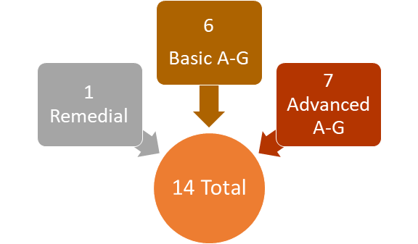
Math Course Offerings
Mathematics Courses Offered at the Sequoia Union High School District (SUHSD)

Slide 14
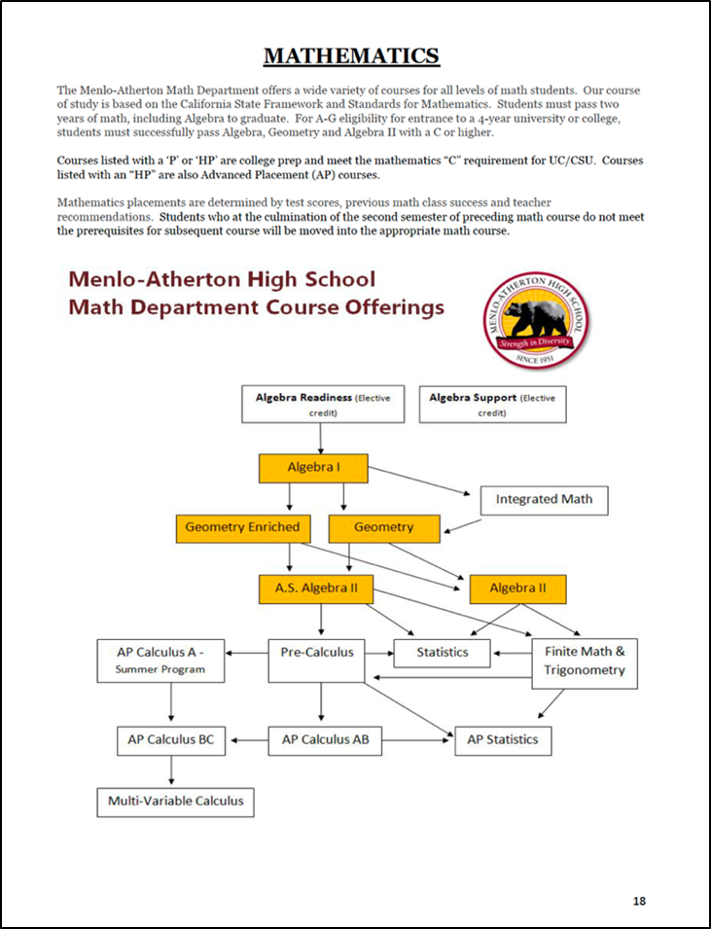
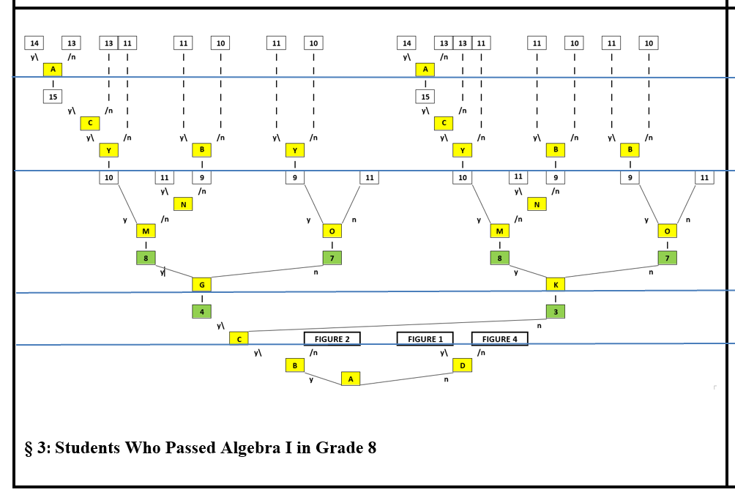
Math Pathways
Across SUSHD, we identified 76 mathematics course pathways.
Only a few of those course pathways may be accessible to LTELs.
Pathways accessible to LTELs may not include A-G advanced courses.
Properly interpreting the information about available courses and their enrollment requirements may be challenging for parents with limited familiarity with the education system.
Notes:
\

Slide 15
Math Placement Tests
In the winter of 2019, we began to study math assessment practices at SUHSD. We still have a great deal to learn, but we think:
LTELs’ access to college-preparatory high school mathematics course pathways may be influenced by Grade 9 placement tests.
Certain placement tests are administered too early in Grade 8, and may not produce dependable measures of mathematics proficiency.

Slide 16
LTEL Passing Rates in Math Courses
We examined the percentages of English-only (EO), Reclassified Fluent English Proficient (RFEP), Short-term English learner (STEL), and Long-term English learner (LTEL) students who enrolled in and passed mathematics courses for four student cohorts: 2015, 2016, 2017, and 2018.

Slide 17
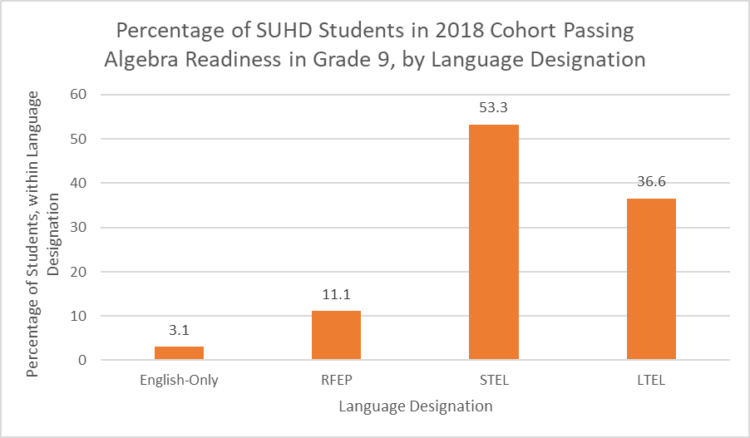
LTEL Passing Rates in Math Courses

Slide 18
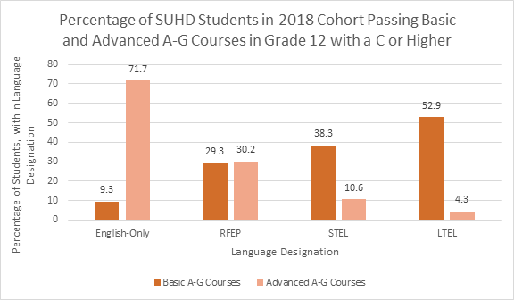
LTEL Passing Rates in Math Courses
Notes:
These do not add up to 100% because this represents students passing with a C (needed for college entry). The remaining students either failed a math course, didn’t take math at all, or were enrolled in a remedial course.

Slide 19
LTEL Passing Rates in Math Courses
Findings suggest that, in 2018, LTELs were overrepresented in remedial mathematics courses in Grade 9, and underrepresented in Advanced A-G courses in Grade 12.

Slide 20
Problems of Practice
Foci for 2019-2020:
How do tests and the interpretation of test results shape the mathematics achievement of LTELs?
How does LTELs’ access to college-preparatory mathematics classes differ across high schools in SHUSD?
How do LTELs describe their high-school experience at SUHSD? What is eighth-grade mathematics like for ELs in RCSD and RSD?
Notes:
JEN—
FEEDBACK: What additional quantitative analysis is being done beyond the study of the assessments?
Cohort analysis of course taking patterns: Woodside, Sequoia, M-A, and Carlmont

